Slide 1

GEOHACKATHON CLOSE OUT PRESENTATION
Team ERCE
Dr Munish Kumar, Staff Petrophysicist, ERCE
Kanna Swaminathan, Senior Reservoir Engineer, ERCE
Ivan Maulana, Senior Geophysicist, ERCE
15th December 2021

Slide 2
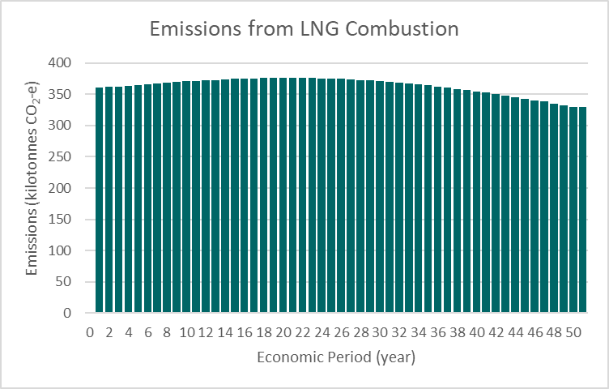
1. Recommendations
The FDP will satisfy 80 MW and 100 MW demand location requirements for 50 years
Summary of Results
No of Existing Wells | 10
No of New Wells | 6
CAPEX (MM€) | 125
OPEX (MM€) [20 years] | 212
OPEX (MM€) [50 years] | 589
Project Duration (yrs) | 50
LCOH (€/MW) at end of life [20 years] | 13.8
LCOH (€/MW) at end of life [50 years] | 11.5
NPV (MM€) [20 years] | 2,542
NPV (MM€) [50 years] | 1,578
Total terawatt-hours over Project Lifetime (TW.hrs) | 9.3
Avoided Fossil Fuel Emissions (Gtonne) | 0.02
Time Series GHG Emissions Savings over Project Lifetime

Slide 3
2. Short background of the project
Two locations (D1, D2) have a demand of 80 MW and 100 MW thermal output respectively.
Within the surrounding area of interests (AOI) measuring 12.5km by 12.5km, 12 pre-existing wells consist of:
(a) 3 producers (P01 to P03),
(b) 3 injectors (I01 to I03), and
(c) 6 exploration wells (E01 to E06)
The team was given a budget for data purchase of EUR120,000, with each well log or well test costing EUR10,000 and EUR15,000 respectively.
Exploration wells prioritised because these wells could be converted to producers/injectors without incurring drilling costs.
Producers and Injectors were considered as interchangeable, and properties assumed close enough to one another such that one well per doublet needed to be analysed.

Slide 4
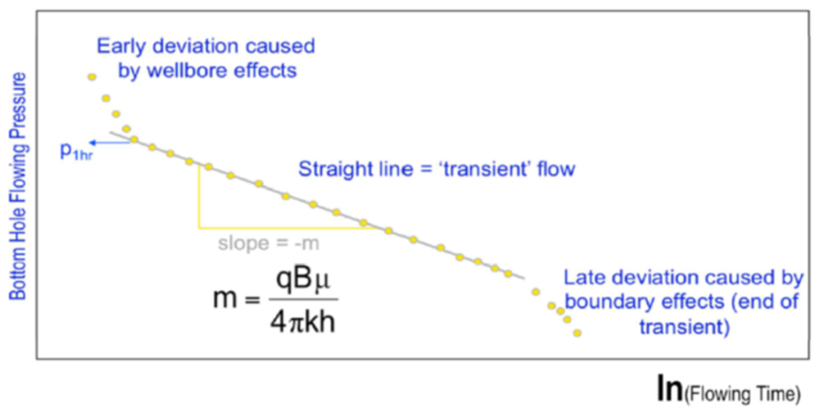
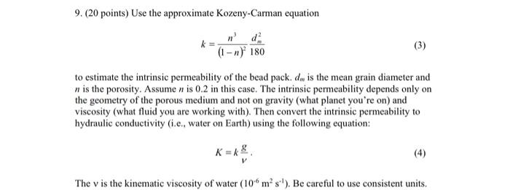
3. Information that was used
Data was purchased from all six exploration wells, with an even split of well test data (E02, E04, E06) and well log data (E01, E03, E05)
Wells within the doublet with the smallest Euclidean distance from any demand location was selected, resulting in well logs purchased for I02, I03, and P01. An additional well test was purchased for P01, which was centrally located among the operating doublets.
More well logs were purchased as they were cheaper; the Kozeny-Carman equation was used to correlate evaluated porosity to permeability through the application of a correlation constant (β).
β is obtained from P01, which is centrally located and is the only well where both data sets were purchased.
Kozeny-Carman equation
Permeability Modeling using Straight Line Transient Flow

Slide 5
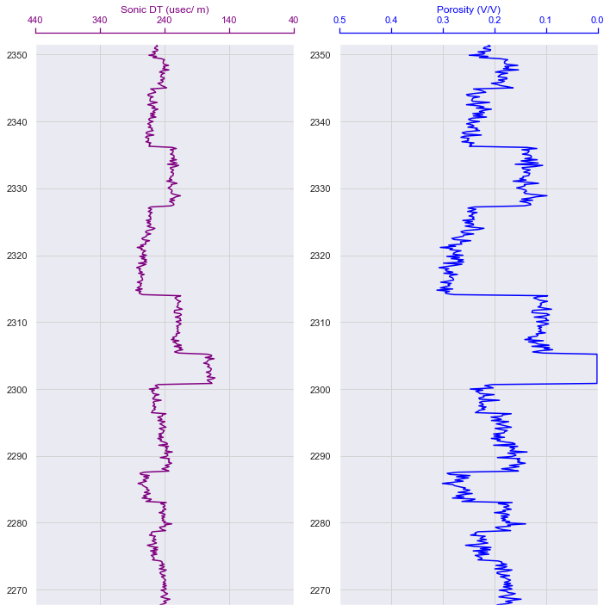
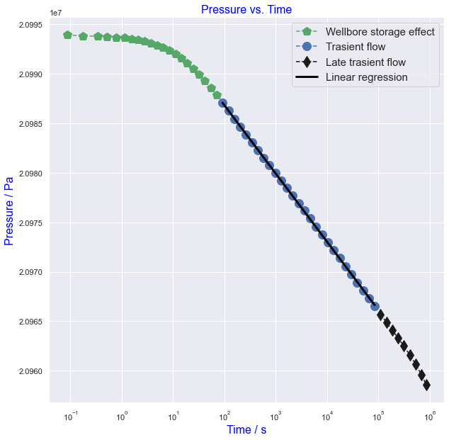
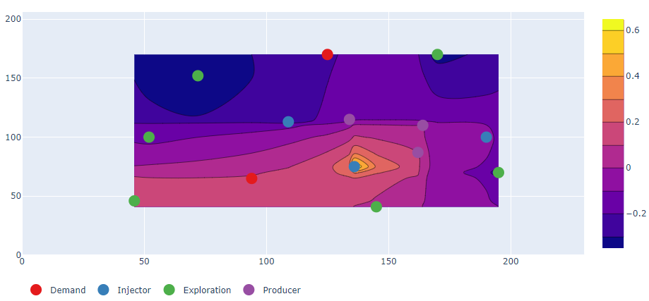
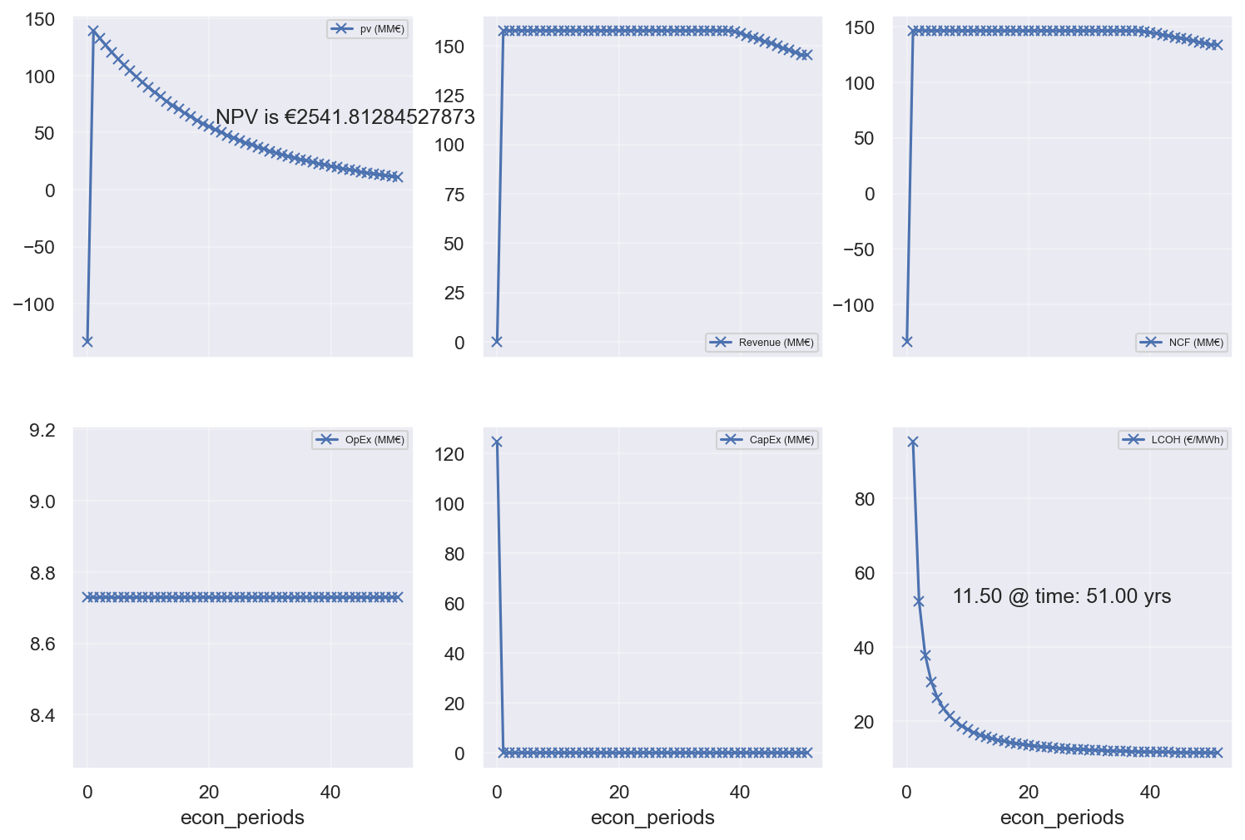
4. Methodology
Input Data
Purchase Well logs & well tests
Static Properties
Interpret Porosity with Wyllie Eqn and Permeability using Drawdown
Fairway Map
Identify drill sweet spots
Base case simulation
Redistribute determined wrt demand location
Change Flow Rates and Well Location
Support Vector Classification (SVC) Model
High-Grade best-case development scenario
Economic Analysis
CAPEX, OPEX, LCOH, NPV
General ML Model
DARTS
Reiterate
Porosity and Permeability Interpretation
Fairway Mapping
NPV
Revenue
NCF
Economic Modelling
OPEX
CAPEX
LCOH

Slide 6
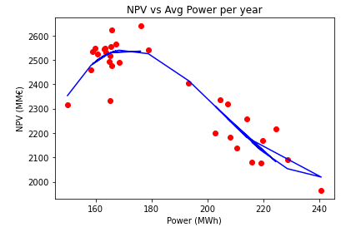
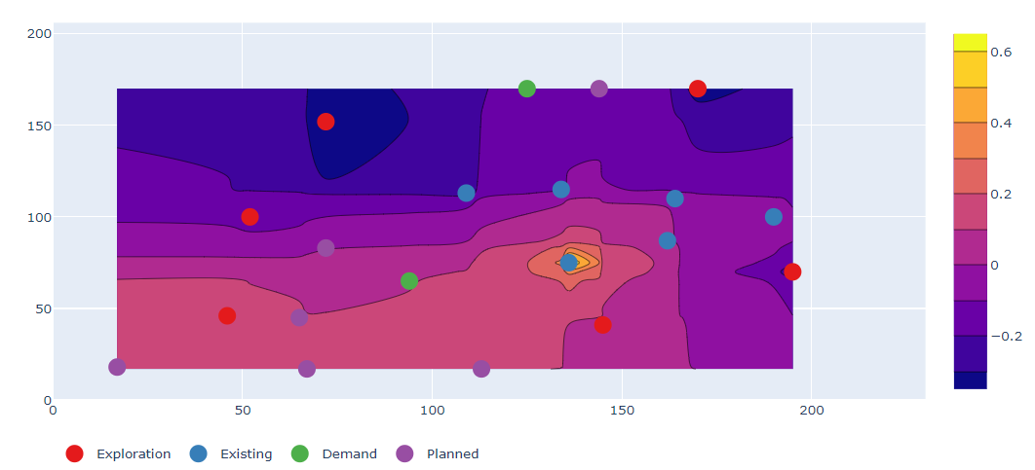
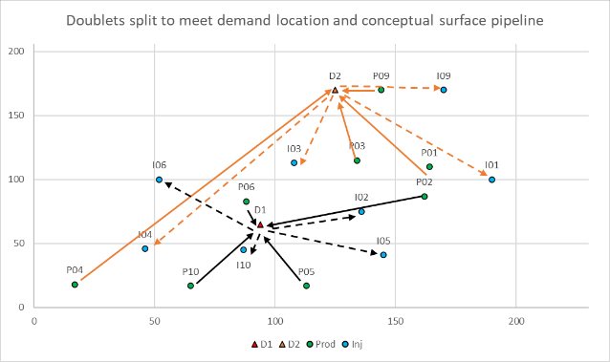
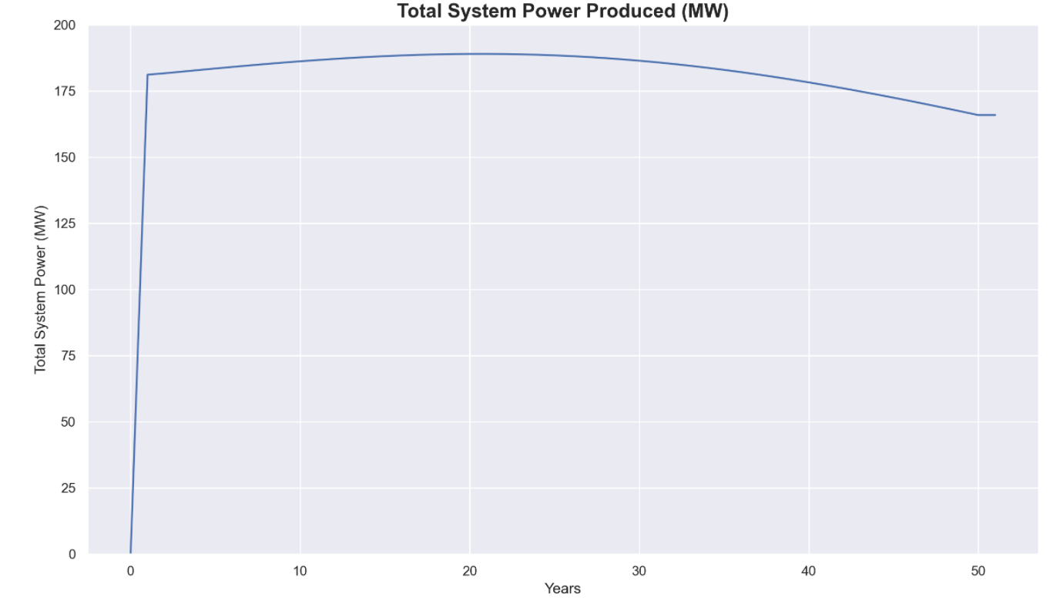
5. Results
A polynomial regression function for all 31 runs was constructed between NPV for 50 years and average power produced per year
One of the earlier runs showing “Sweet Spot” Drill location for 20 wells
Development Plan depicting surface facilities
The team used an SVC method to ensure that each demand location was supplied with the right amount of power
>180 MW produced in years but drops to < 180 MW after ~40 years.
The total power produced per year on average is 178 MWh

Slide 7
6. Conclusions
Generalised Data Model
Using 31 DART runs, the team generated a dataset consisting of system power per year over a 50-year period, corresponding net present value and LCOH.
We applied using a multivariant linear regression method, to predict optimal rate reductions needed to satisfy demand outputs, given some input well locations.
Risks
(a) lack of or poor reservoir (unable to meet water rate), (b) premature breakthrough, (c) sand production and (d) frequent ESP failures.
Mitigated by (a) improved seismic mapping and well logging of reservoirs, (b) planning for workovers to replace ESPs and maintain flow rate, (c) reduce drawdown to prevent sand production and recompletion of well with sand screens

